Slide 1
Custom Vision with Azure Vision Services
12/14/2019
Global AI Saturday
BOSTON COLOMBIA UKRAINE

Slide 2
Agenda for today
Create Custom Vision Project
Train our Model
Test our Model
Publish our Model
Build Application to Consume our Model

Slide 3
Resources
https://www.customvision.ai/
https://github.com/MILL5/ext-cogsvcs-vision

Slide 4
Custom Vision API
Train
Test
Deploy
Build Training Dataset
Train the dataset
Use Test Dataset to Test
Model
Create an Endpoint
Build Application

Slide 5
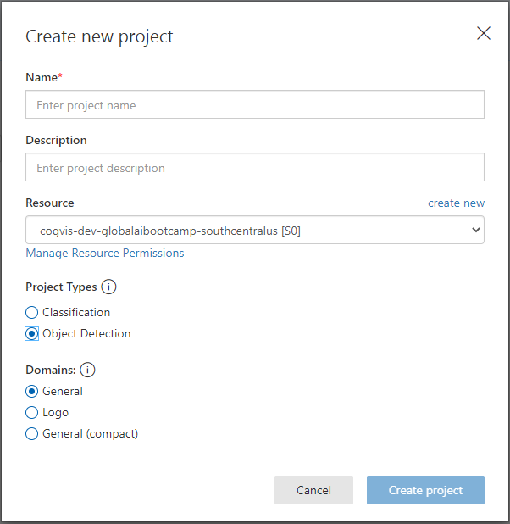
Custom Vision Project
Project Type: Object Detection
Domains: General

Slide 6
Custom Vision API
Train
Test
Deploy
Build Training Dataset
Train the dataset
Use Test Dataset to Test
Model
Create an Endpoint
Build Application

Slide 7
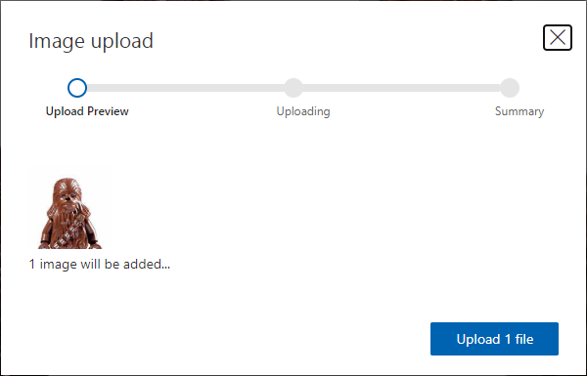
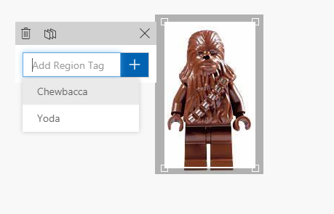

Upload and Tag Images
https://github.com/MILL5/ext-cogsvcs-vision
Building your dataset
Azure Databricks
Azure Machine Learning
Adding training images to you project
Upload 1 to N images. Need at least 15 images per tag to train the model
Tag each image with appropriate label
Create the smallest bonding box possible

Slide 8
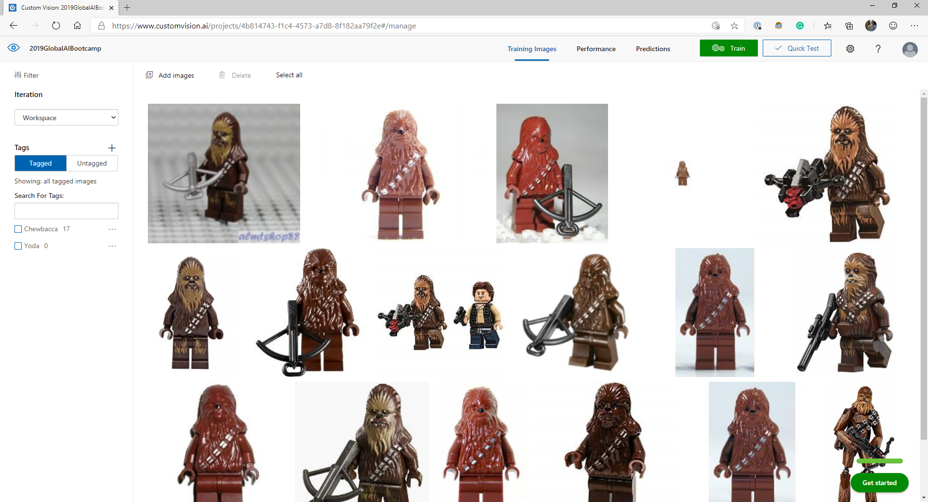

Slide 9
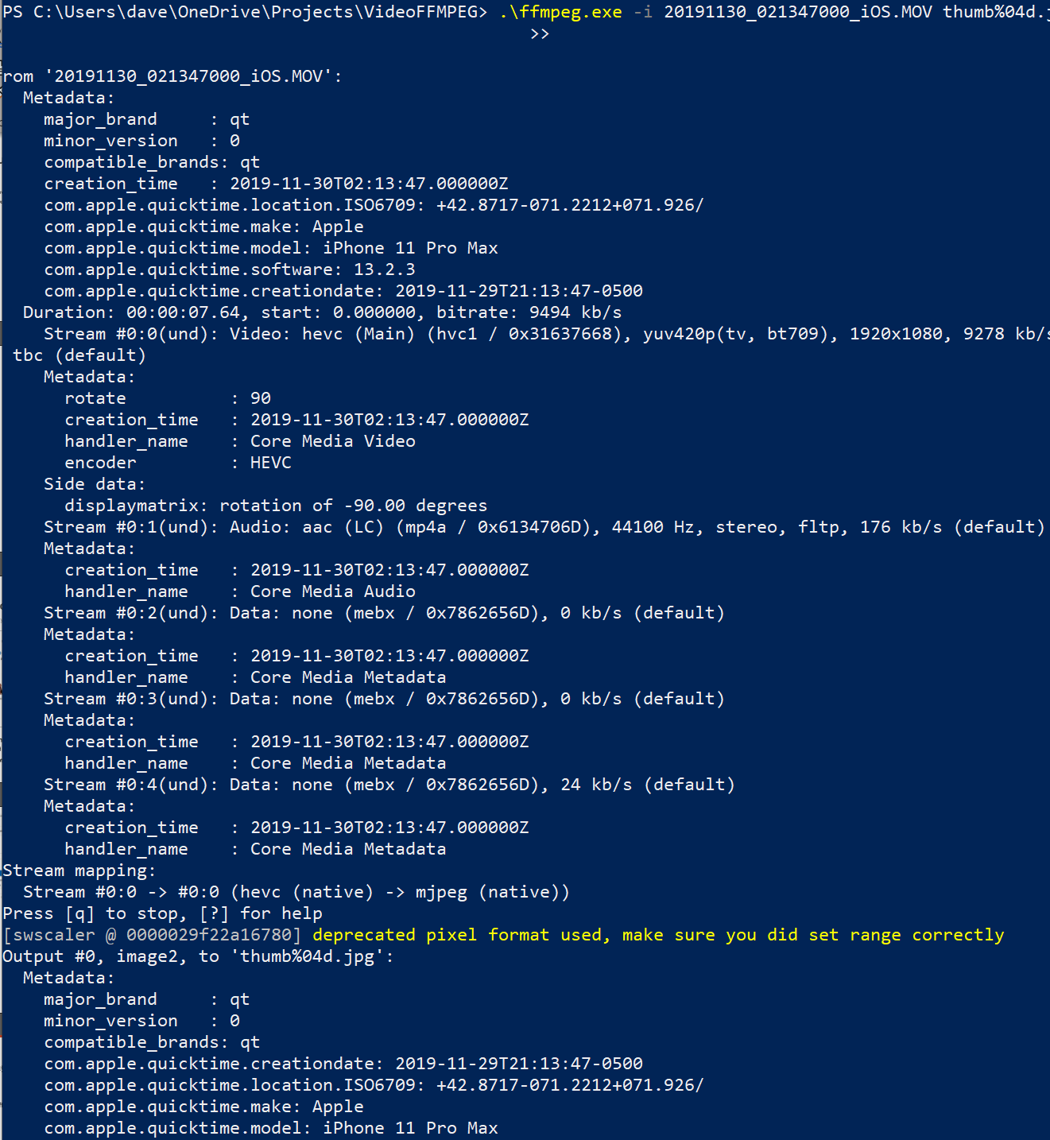
Image Capture Tip - https://ffmpeg.org/
ffmpeg -i video.webm thumb%04d.jpg -hide_banner

Slide 10
Custom Vision API
Train
Test
Deploy
Build Training Dataset
Train the dataset
Use Test Dataset to Test
Model
Create an Endpoint
Build Application

Slide 11
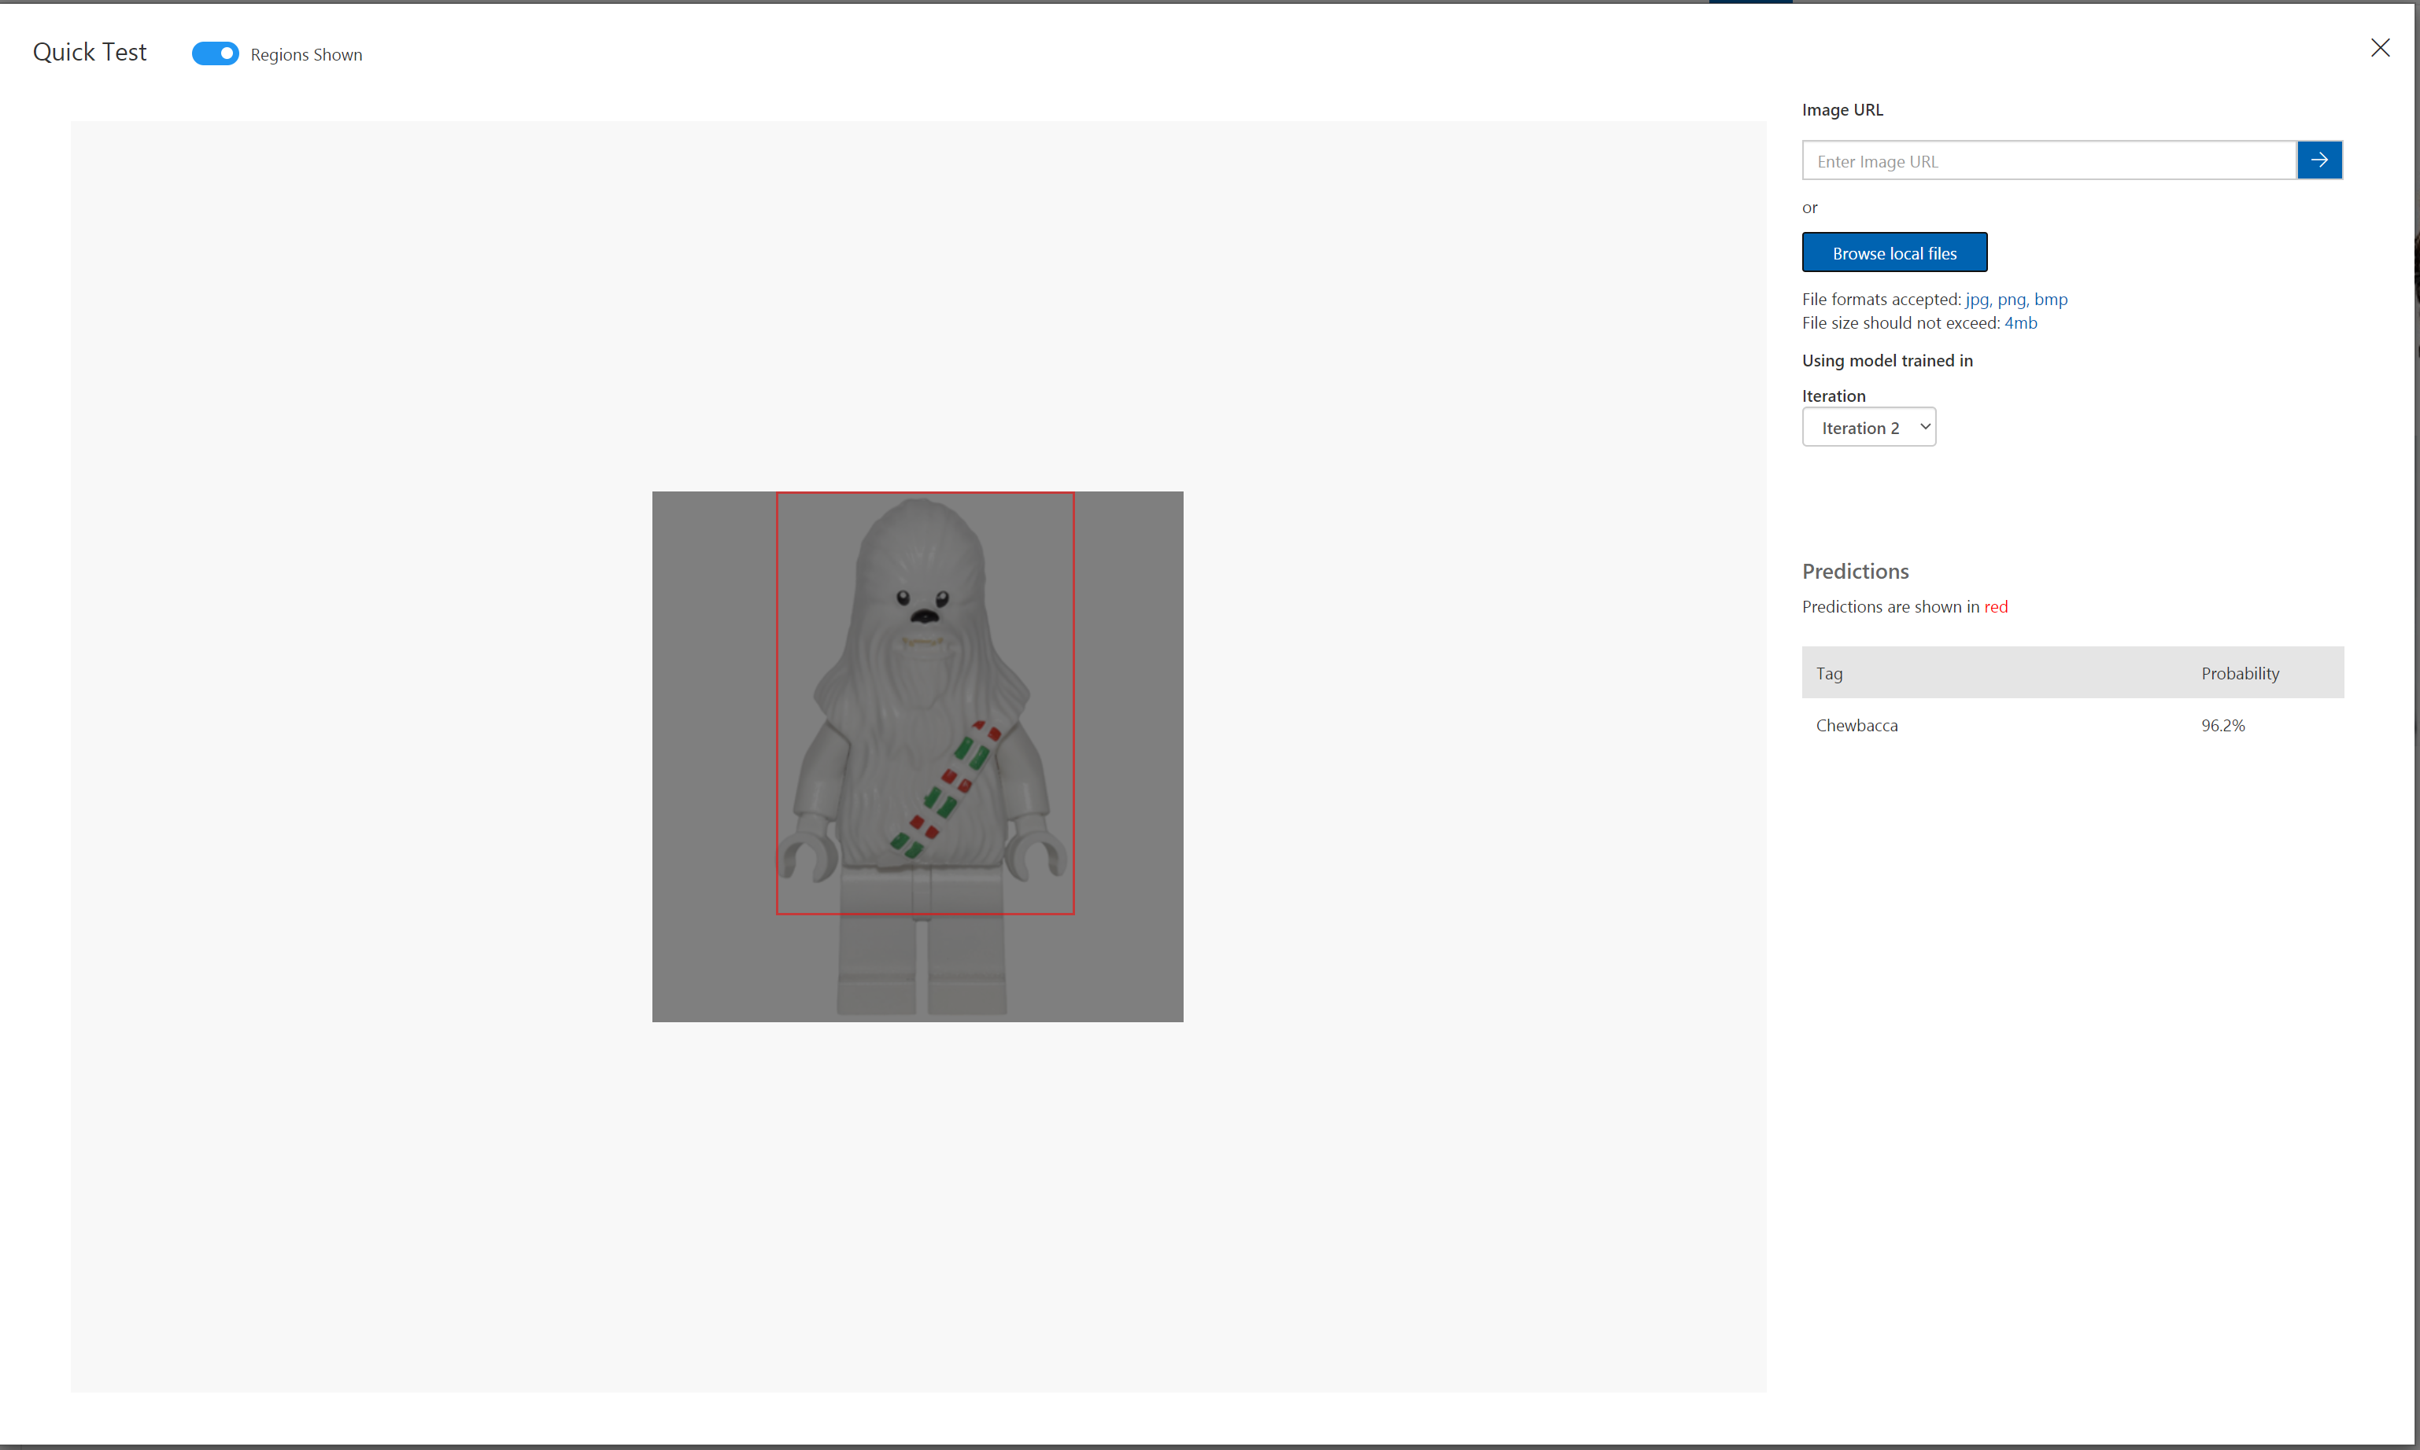
Testing Your Model
A quick test

Slide 12
Custom Vision API
Train
Test
Deploy
Build Training Dataset
Train the dataset
Use Test Dataset to Test
Model
Create an Endpoint
Build Application

Slide 13
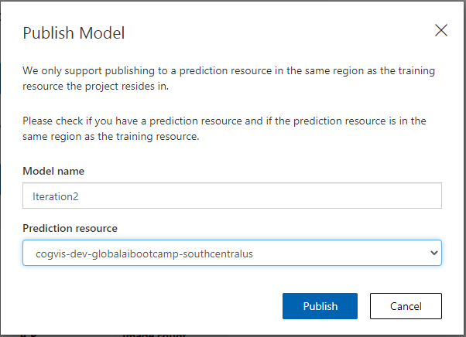
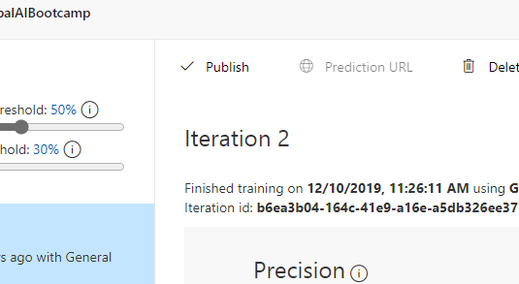
Publish You Model
Azure Databricks
Azure Machine Learning
Start Publishing
Select Publish on the performance page
Publish Model Dialog
Give your model a name
Select the Prediction Resource

Slide 14
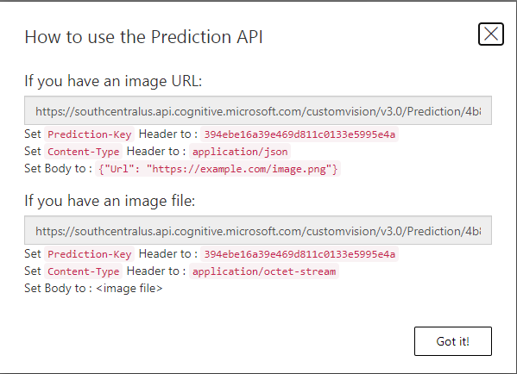
Prediction URL

Slide 15
Further Reading
https://docs.microsoft.com/en-us/azure/cognitive-services/custom-vision-service/

Slide 16
Thank you!
Dave Davis, Senior Architect
daved@mill5.com
MILL5
200 Portland Street
Boston, MA 02114
www.mill5.com
BOSTON COLOMBIA UKRAINE

